Slide 1
Thailand’s Universal Coverage Scheme:
An independent assessment of the first 10 years (2001-2010)
Presentation to Satellite Meeting of PMAC
24 January 2012
Timothy G. Evans BRAC University
Viroj Tangcharoensathien IHPP
Pongpisut Jongudomsuk HSRI
Samrit Srithamrongsawat HISRO

Slide 2
Outline of presentation
Background:
Thailand and the long path to universal coverage
Ten year assessment
Aims and framework for assessment
Findings:
1: enabling factors leading to UCS
2: implementing the UCS
3: UCS governance
4:UCS achievements
5: spill over effects
Challenges ahead in the next 10 years
Conclusion

Slide 3
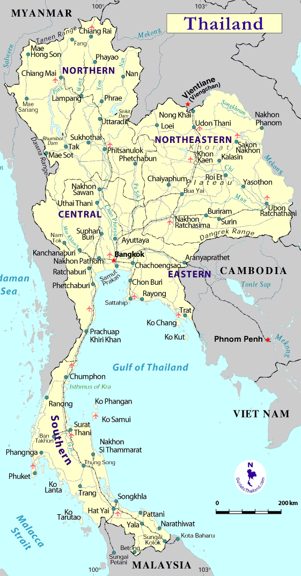
Background
GNI/cap - US $ 4,210 (2010)
Population - 67 million
Total fertility rate – 1.6 (2009)
Life expectancy at birth – 74.1 years
Under 5 Mortality – 14/ 1000 live births
Maternal mortality – 48/100,000 live births
Health Expend/cap – US $175 (2009)
Physicians/cap – 4/10,000
ANC & SBA coverage - 99-100% (2009).

Slide 4
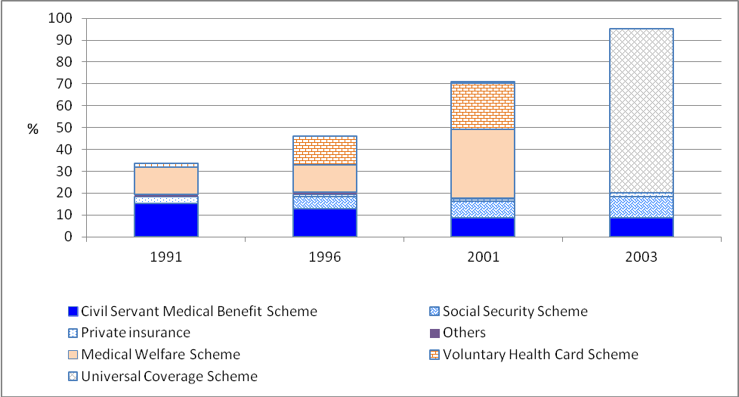
Thailand’s path to universal coverage

Slide 5
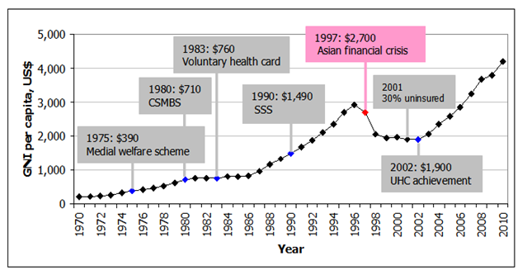
Thailand’s path to universal coverage
Notes:
After four decades of health infrastructure development and three decades of designing and implementing a number of different health insurance schemes, Thailand achieved UC in 2002, at the time when the country remained affected by the 1997 Asian Economic Crisis

Slide 6
Aims and Framework

Slide 7
Aims of the assessment
To assess the performance of the UCS after 10 years
implemented as designed?
achieved its intended impact?
To shed light on what did and did not work… and why
To offer policy recommendations for UCS moving forward
To capture lessons that may help other countries on the path towards universal coverage.

Slide 8
Scope of the UCS assessment, 2001-2010
who
how
why
1. UC Policies process & system design
Structure
4. governance
2. Contextual environment
Power
UCS
Governance NHSO
3.implementation
MOPH
NHSO
Purchaser-provider split
Strategic purchasing
Harmonization
5. Impact
Health system
Providers
Population
Macroeconomics
Primary care development
Medical service delivery
Public health functions
Information system
Human resources
Service pressure
Financial
Efficiency
Utilization
Financial protection
Perception
Economic activities
Consumption and precautionary saving
Government consumption
Production & import pattern

Slide 9
Study Teams
1. Policy formulation and system design | Viroj Tangcharoensathien, Siriwan Pitayarangsarit, Hathichanok Sumalee, Phusit Prakongsai, Walaiporn Patcharanarumol, Jiraboon Tosanguan, and Nucharee Srivirojana
2. Contextual environment | Vinai Leesmidt, Pinij Faramunayphol, Nusaraporn Kessomboon, Boonchai Kijsanayotin, Kanchit Sooknark, and Supasit Pannarunothai
3. UCS implementation | Samrit Srithamrongsawat, David Hughes, Jadej Thammatach-Aree, Weerasak Putthasri, and Songkramchai Leethongdee
4. Governance of the UCS | Paibul Suriyawongpaisal, Thira Woratanarat, and Rassamee Tansirisithikul
5.1 impact on health systems | Piya Hanvoravongchai, Yongyuth Pongsupap, Jiruth Sriratanaban, Pinij Faramnuanphol, Boonchai Kijsanayotin, and Nonglak Pagaiya
5.2 impact on MOPH hospitals | Watchai Charunwathana
5.3 Impact on households | Supon Limwatananon, Viroj Tancharoensathien, Phusit Prakongsai, Chulaporn Limwatananon, and Areewan Chiewchanwattana
5.4 Impact on macroeconomics | Somprawin Manprasert and Worawet Suwanrada

Slide 10
Study Team: International Advisors
Timothy G. Evans BRAC University
Mushtaque R. Chowdhury Rockefeller Foundation
David Evans World Health Organization
Armin H. Fidler World Bank
Magnus Lindelow World Bank
Anne Mills London School of Hygiene & Tropical Medicine
Xenia Scheil-Adlung International Labour Organization

Slide 11
Findings 1: Enabling Factors for UCS

Slide 12
Enabling factors for UHC
Increasing evidence and intolerance of inequities
18 million remained uninsured
Inequitable distribution of health resources
Skews towards hospital care, urban areas
Building on a strong foundation
right to access health care to all Thais
1997 Constitution
Extensive coverage of health care facilities
MOPH district health systems
Institutional capacity to mange reforms
Public administration and MOPH
Evidence and intelligence
Strong health system research capacity
A computerized civil registration system

Slide 13
Enabling Factors for UHC: The triangle that moves the mountain
Political commitment:
“Access to healthcare services for all”
8th Ntl Socio-Eco Development Plan (1997-2001)
“30 baht treat all diseases”
Election 2001 - TRT party campaign slogan;
Universal Coverage became one of 9 priorities of new government
Civil society mobilization:
NGO network submits draft bill on UC to parliament with >50,000 signatures
Technical know-how:
MoPH leaders forms working committee to study feasibilty of UC

Slide 14
UCS: clear expectations
Extend coverage to all
Universal benefits packages with emphasis on primary care
Decrease out-of-pocket payments
Harmonize UCS with other government financed insurance systems

Slide 15
A deliberate design
Nature | Entitlement, tax-based system
Financing model | Public contracted model, capitation 1,899 THB in 2007
Beneficiaries | Thai citizens uncovered by SSS and CSMBS (47 million)
Benefit package | Comprehensive package including prevention and promotion services (PP) and accredited alternative medicines with an exclusion list of some services
Service providers | Contracted public and private hospitals and requiring all hospital to establish one primary care unit (PCU) for every 10,000-15,000 registered population
Payment method | OP,PP - Capitation IP - DRG weighted global budget A/E and HC OP – point system, AE/HC IP –DRG weighted global budget
Notes:
For the UC scheme. It is an entitlement, tax-based system.
The scheme employs a public contracted model with both private and public hospitals. In 2007, the scheme receive government budgets of 1,899 Baht per capita, equivalent to 54USD.
All Thai citizens not covered by the SSS and CSMBS will be covered by this scheme, currently it covers around 47 million or 75% of the populations
The scheme provides a comprehensive health services package, including ambulatory care, medicines, dental care, hospital care, and prevention and promotion services. It should be noted that personal health promotion and prevention services are provided to all Thais not just only those covered by the UC scheme.
All public hospitals and accredited private hospitals are chosen as main contractors and all of them are required to set up one primary care unit for every 10,000 – 15,000 registered members.
Capitation payment is chosen to pay for ambulatory care and prevention and promotion services. A Diagnosis Related Group with global budget is employed to pay for inpatient care. In order to enable access to accident emergency services and high cost care, a reinsurance system is also established and paying hospitals by point system for outpatient services and DRG with global budget for inpatient services.

Slide 16
New institutional arrangements of the UCS
National Health Security Board
Minister of Health
Financial flow
Command line
Coordination
NHSO
MOPH
Adm. budgets
Regional NHSO
Regional NHSB
Health Regional inspector
Contracting
Referral hospitals
Non-UC budgets Salaries
Provincial Health Office
District governor
Other public CUPs
UCS
budgets
District Health Office
MOPH CUPs
CUP board
Private CUPs
MOPH PCUs
Full cost
Local administrative offices
Sub-district Health Funds
Notes:
This slide presents current institutional arrangements of the UCS. At the national level, there are the NHSO as purchaser and MOPH as major provider, the UCS is steered by the National Health Security Board chaired by the Minister of Health.
At the regional level, there are 13 regional office of NHSO. the Bangkok branch office was established at the time of the creation of the NHSO due to lack of an arm-length unit to deal with many providers in Bangkok, unlike other provinces that there is a provincial health office. The second branch office was established in Khonkhaen in 2004 following the continuing conflicts between NHSO and MoPH and by the recognition that it need a regional office to coordinate contracting with local providers. At this level, there is a Regional Health Security Board chaired by a local elected board member, usually a retired health administrator.
At the provincial level, there is a Provincial Health Office who acts as provincial office of the NHSO. The PHO acts as secretary of the Provincial Health Security committee chaired by the PCMO. In fact, the PCMO is also officers in the line-command MoPH system so the PCMO is charged with duo functions, both purchaser and provider.
The central NHSO contracts directly with CUPs based in MoPH hospitals, private hospitals and non-MoPH public hospitals but allows the PHO to advise on the number of beneficiaries allocated to private and non-MoPH hospitals. Some public and private secondary or tertiary care hospitals are also contracted as referral centers of UCS. Moreover, NHSO also contracts some private clinics and medical centers of MoPH and municipalities as a contracting unit but only for outpatient services with a hospital back-up for referral cases.
All public and MoPH facilities are required by government policy to be providers under the UCS. District and provincial hospitals are main contractors of the UCS and health centers located in the same district are assigned to be primary care networks. Management of service provision and the UCS budget within CUP is undertaken by CUP Board, which is usually chaired by the director of district or provincial hospital. Then the degree of support given and the formula used for allocating budgets to PCUs varied substantially, both between CUPs and Provinces. This sometime resulted in conflict between hospital and PCUs. In some provinces this caused concern among MoPH and PHO administrators, and led to additional guidance for MoPH CUPs in allocating UCS budgets to health centers. However, a more recent study suggests that the degree of technical, material, and financial support to primary care has increased substantially as a result of the UCS reforms, even in CUPs where conflict was reported.
In 2010, the government a new policy to strengthen PMC by upgrade health centers to be “Subdistrict Health Promotion Hospitals” it aims to renovate and upgrade the capacity of health centers to deal with unmet needs and solve the problem of overcrowded outpatient departments in MoPH hospitals. The MoPH chanelled additional budgets through PHOs to upgrade health centers; however, shortage of human resources remains a major obstacle of implementing this policy.
“Tambol Health Fund” is another innovation lunched in 2006. this fund is made up of matching contributions from the NHSO and local governments, which aims to improve health promotion and prevention activities including community health, and to empower local government officers and community groups.

Slide 17
Finding 2: implementing the UCS: institutional conflicts and resistance to change
Purchaser-provider split
Strategic purchasing and equitable resource allocation
Harmonization of current public insurance schemes

Slide 18
2.1 Purchaser-provider split
National Heath Security Offices (NHSO)
the purchaser of services on behalf of members
ensures member’s right to standard package of services.
Ministry of Public Health (MOPH)
the provider of services on behalf of members (not exclusive)
Previously also the purchaser of services
New purchaser-provider split
More responsive, transparent and accountable to the UCS beneficiaries.
increase in access to information, process to make complaints, and no-fault compensation
increase in patients’ satisfaction.
Greater engagement of diverse stakeholders at all levels
Stakeholders: professionals, private providers, civil societies, and local administrative organizations
Levels: national, regional, provincial level, and sub-district.
Prevention of conflict of interest with separation of purchasing and provision
BUT, with less consumer choice due to “single” provider monopoly of MOPH

Slide 19
2.1 Purchaser-provider split
Tensions between the purchaser (NHSO) and provider (MOPH)
In eyes of purchaser – provider seen to be inefficient and over-funded i.e., “Squeezing the fat” “Get rid of the fat”
In eyes of provider – purchaser seen to be insensitive and ignorant of patient care needs
In reality – the separation not clear-cut – many Ill-defined areas in defining relationship between purchaser and providers
NHSO introduced the term “system manager” instead of “purchaser” since:
The term “ purchaser-provider” unpalatable to medical professionals
Simple concept of purchasing overlooks systems complexity of inequitable distribution of health resources and lack of essential services in some areas
Efforts to “mend” the split:
NHSO gives doctors a central role in the selection and development of targeted services
A new “strategic partnership” through “local commissioning” being piloted

Slide 20
2.2 Strategic purchasing: the move to demand side financing
UCS reform shifted from “supply” to “demand” side financing:
A capitation allocation system whereby monies follow patients
However, implementation hampered due to “difficult-to-change” institutional factors of MoPH hospitals including:
employment and salary conditions of staff protected by civil service laws
the need to ensure financial viability of MoPH hospitals
the absence of viable competitors to MoPH hospitals in many areas
As a result –
Realization that it is impossible to effectively reform the system by solely employing financial mechanisms
NHSO has moved a bit to supply-based to keep the system balance..
… and use of more refined demand side mechanisms such as “post-paid budgets” and purchasing of targeted services.

Slide 21
2.3 Harmonization of 3 government financed insurance schemes
Rationale for harmonization
Inequitable practice variations in service provision for high cost procedures, high cost drugs
Concerns about duplication and inefficiencies
Main objectives
Improve equity – remove disparities in benefit coverage
Improve efficiency – have a single administration unit
Coordination committee process
Limited to technical coordination
Failed to tackle policy and institutional imperative issues
New organization created (NHFDO)
To improve governance of health insurance systems

Slide 22
Findings 3: Governance of UCS

Slide 23
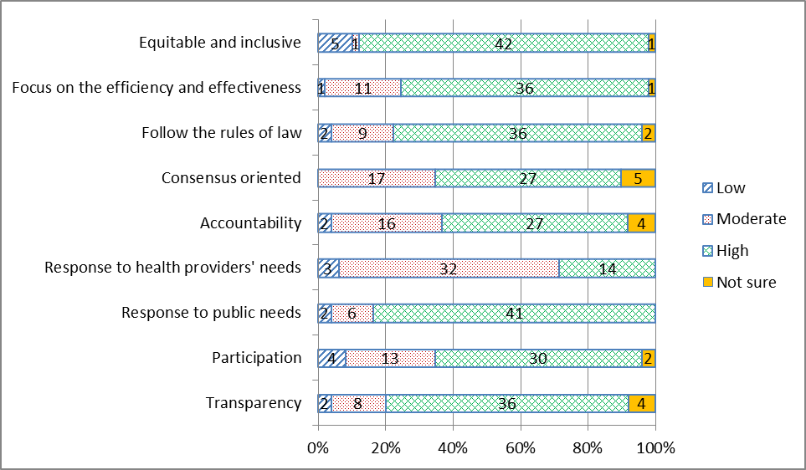
Governance: good, but room for improvement

Slide 24
Findings 4: Achievements

Slide 25
Financing Sources
With UCS, general tax and SHI contributions now constitute 2/3rd of total health expenditure
Overall health expenditure is very “progressive” or pro-poor (as measured by Kakwani Index)
With UCS there has been a marked decline in out-of-pocket expenditure as a mechanism for financing health care.
With UCS the rich-poor gap in out-of-pocket expenditure has been eliminated

Slide 26
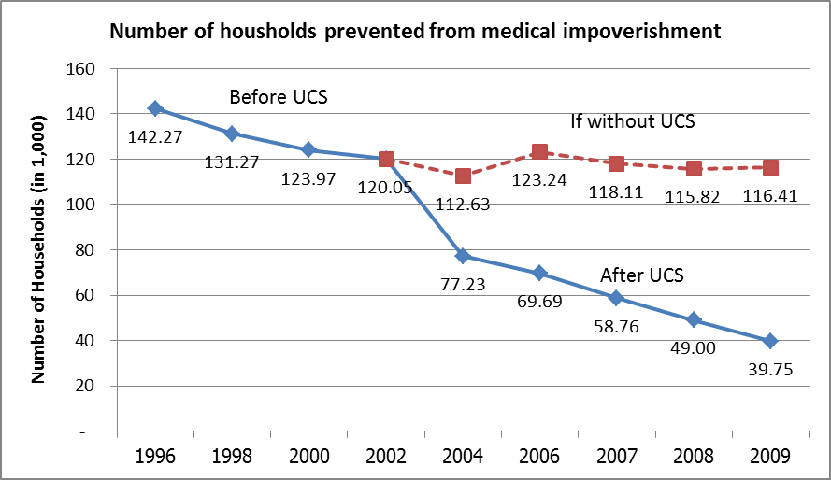
4.1 UCS prevented medical impoverishment

Slide 27
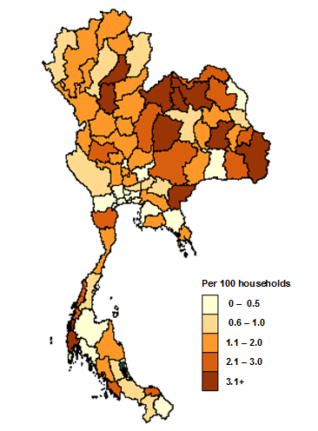
4.1 UCS prevented medical impoverishment
Household medical impoverishment map before and after UCS
1996 | 2002 | 2008

Slide 28
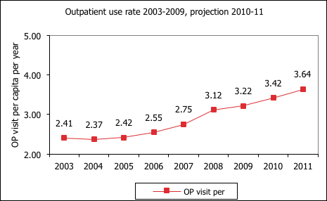
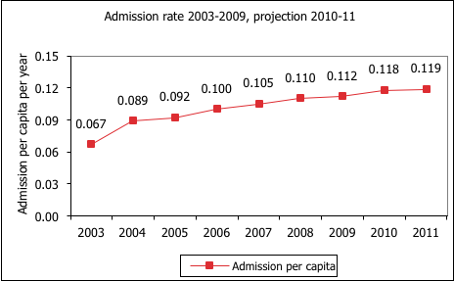
4.2 UCS improved access to needed health services
rising health service utilization and low un-met need
Prevalence of unmet need | OP | IP
National average | 1.44% | 0.4%
CSMBS | 0.8% | 0.26%
SSS | 0.98% | 0.2%
UCS | 1.61% | 0.45%

Slide 29
4.3 UCS improved equity in service utilization
Ambulatory care:
concentration index

Slide 30
4.4 UCS increased equity in public subsidies

Slide 31
Findings 5: Some spill over effects
Health system
Macroeconomics

Slide 32
5.1 Spill over effects on the health system
District level investment of UCS increased technical quality and coordination amongst providers.
Close-end payments i.e. capitation, pushed providers to contain costs and increase efficiency,
Requirements for accountability led to “costly” improvements in information systems.
Facility-based, financing focus of UCS led to under-investment in public health functions.
UCS effectiveness limited by, and unable to make significant in-roads on, chronic problems of health workforce

Slide 33
5.2 Spill over effects on macroeconomics
No evidence of macro-economic instability associated with increased government expenditure on health over 10 years
Increased government health spending due to UCS is not associated with decreased public expenditures in other sectors.
Even though the UCS removed uncertainty in health spending by households, the scheme has not led to a decline in precautionary savings.
With UCS, a rapid, domestic, expansion of Thai medical products sector – a “crowding-in effect”.

Slide 34
Challenges ahead in the next 10 years
Continuing to define the roles of the NHSO and MOPH
Beyond a simple split
Prioritizing public health interventions
Opportunities for stakeholder participation
Balancing scale efficiencies of centralization with local responsiveness and accountability
Synergies or silos with other government financed insurance programs? Or private insurance?
Notes:
First and foremost, the capacity of health service infrastructure, district health systems if the critical strategic hub in translating policy wishes into reality. It is geographically accessible by rural poor, A functioning PHC is not possible if there is no health workforce there. We introduced mandatory rural services since 1972.
Access to care is not possible without removal of financial barrier through financial risk protection policies.
It is the national health plans which ensure continuity of policies and programs.
It is the merit of different political leaders in continuing good programs,
It is the evidence which shows these programs deserve continuity.

Slide 35
Challenges ahead in the next 10 years
Cracking the health workforce coverage nut
Civil servant status and health exceptionalism
Regulating market forces leading to mal-distribution
Reforms of health professional education
Managing growth of the UCS in view of cost pressures from demographic change, economic development, increased demand, and technological advances
Notes:
First and foremost, the capacity of health service infrastructure, district health systems if the critical strategic hub in translating policy wishes into reality. It is geographically accessible by rural poor, A functioning PHC is not possible if there is no health workforce there. We introduced mandatory rural services since 1972.
Access to care is not possible without removal of financial barrier through financial risk protection policies.
It is the national health plans which ensure continuity of policies and programs.
It is the merit of different political leaders in continuing good programs,
It is the evidence which shows these programs deserve continuity.

Slide 36
Conclusions

Slide 37
Conclusions
UCS did not affect only increased access to care of beneficiaries,
It also led to:
reduction of household poverty;
improved equity in financing health;
more equitable access to care; and
gains in the efficiency of the Thai health system.

Slide 38
Design Features linked to success of UCS
Secure source of finance: general tax revenue
Fixed budget = budget per capita x no. of beneficiaries
Comprehensive benefit package:
Outpatient, inpatient, primary prevention, accident and emergency, hospital care
Purchaser/provider contract model:
Focus on primary care:
Registration at primary care is needed and primary care is a gatekeeper
Close-end provider payment:
Capitation for out-patient care and DRG with global budget for In-patient care

Slide 39
Contributing Factors to Effective Implementation
Systems design for equity and efficiency
Supply side capacity to deliver services
Extensive geographical coverage of functioning primary health care and district health systems
Long-standing policy on government bonding of new graduates (doctors, nurses, pharmacists and dentists) for rural services
Strong leadership with sustained commitment
Continued political support despite changes in government
Capable technocrats
Active civil society

Slide 40
Contributing Factors to Effective Implementation
Strong institutional capacities
Information systems
Burden of Disease, National Health Accounts, National Drug Account, National AIDS Spending Account, national household datasets for routine equity monitoring
Health technology assessment
HITAP institutional relation with UK NICE
Key platforms for evidence informed decision
National Essential Drug List sub-committee
Benefit package sub-committee
mandatory budget impact assessment for new drugs/interventions
Health systems research
evidence generation and translation to support policy

Slide 41
Thank you

